Slide 1
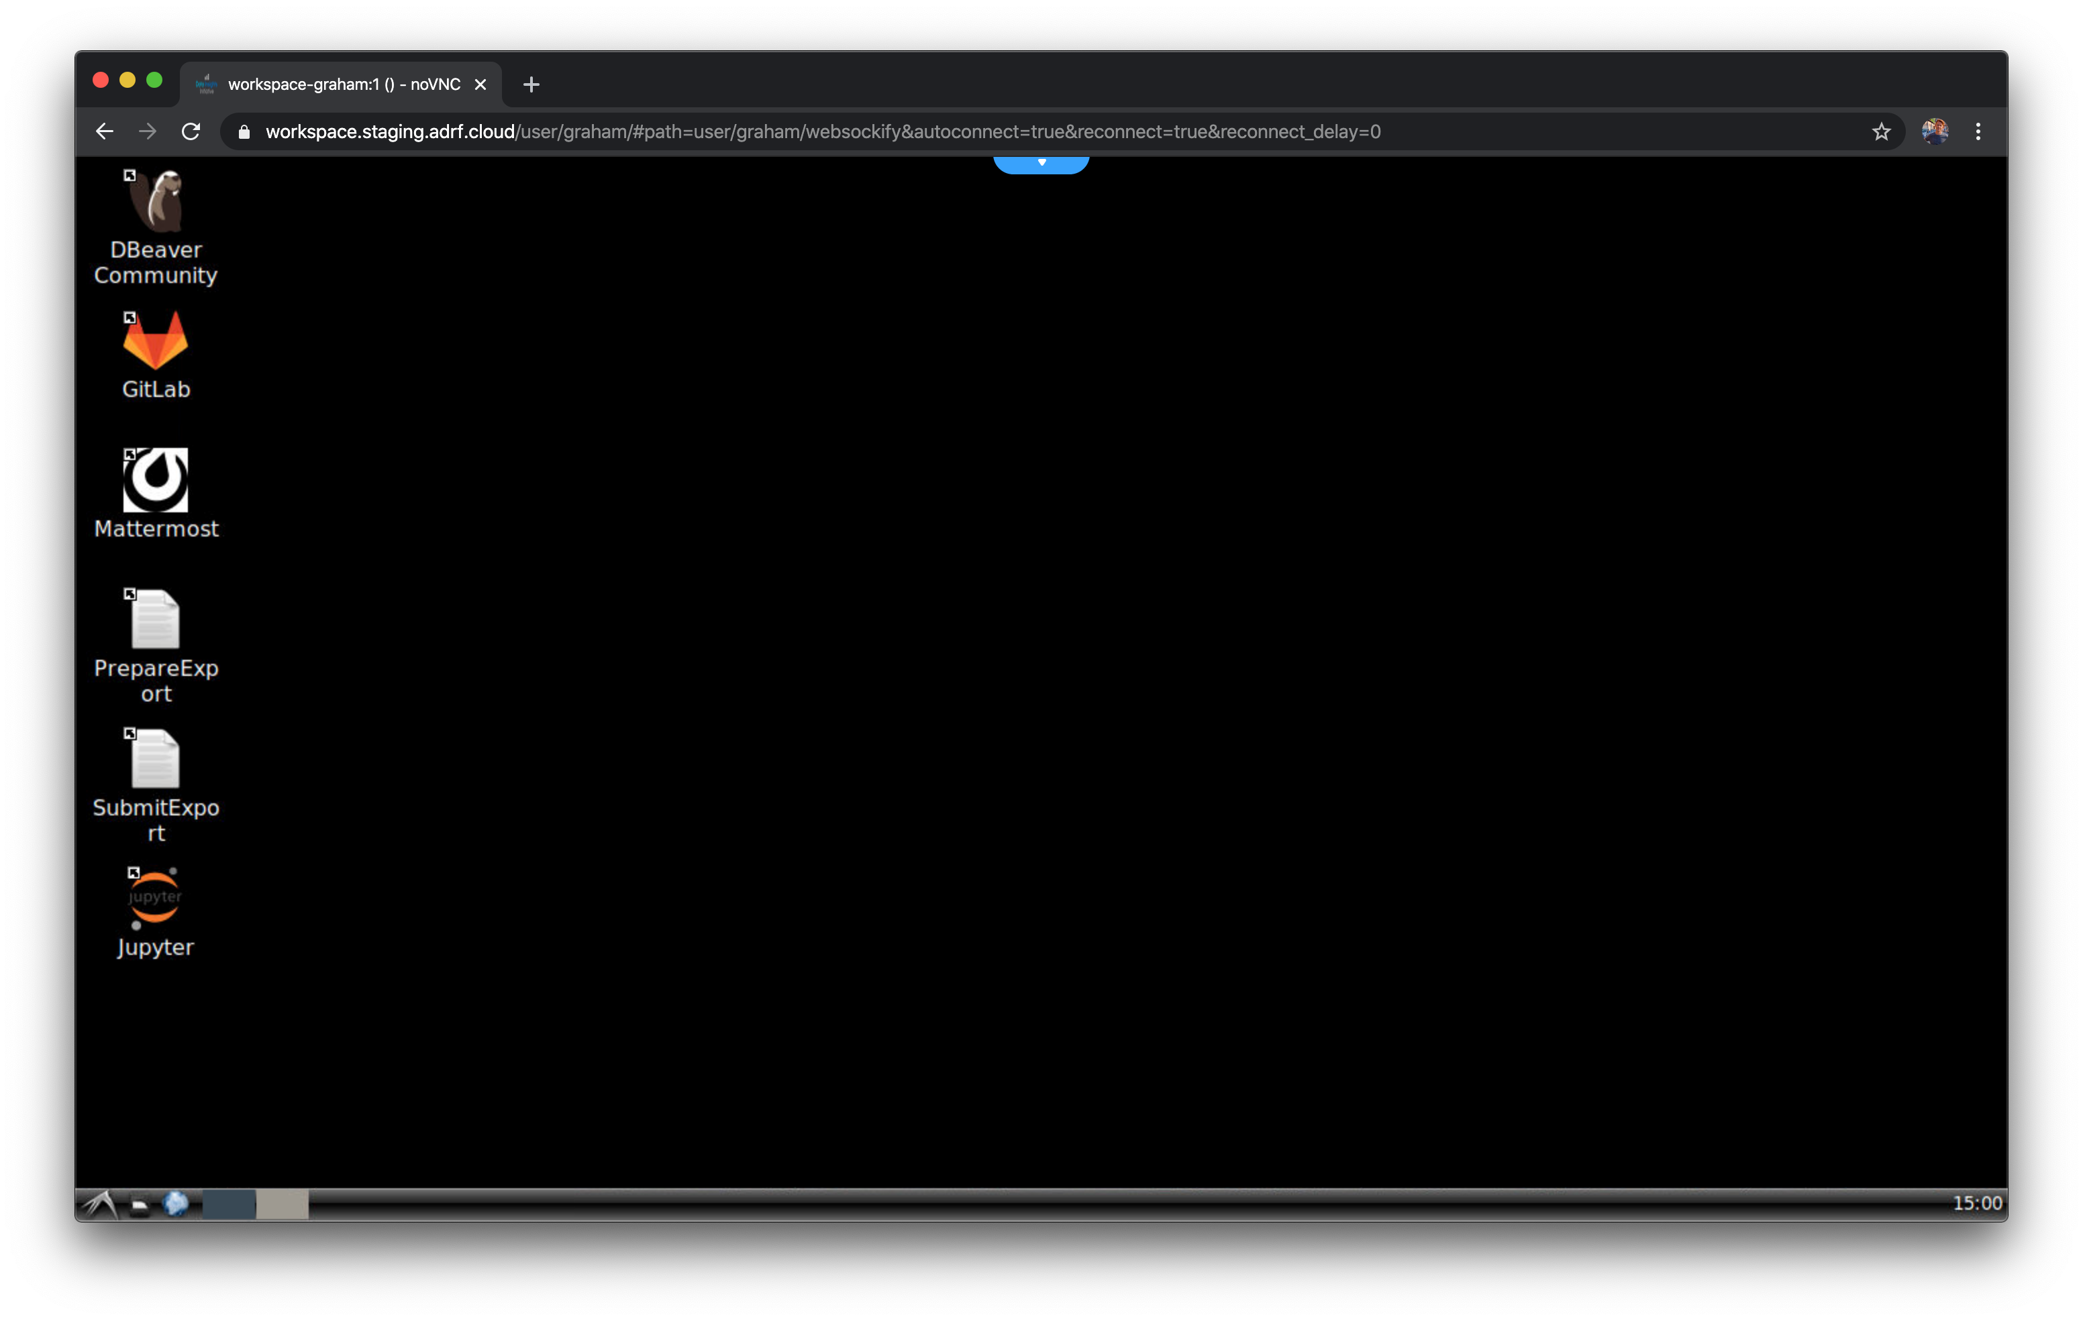
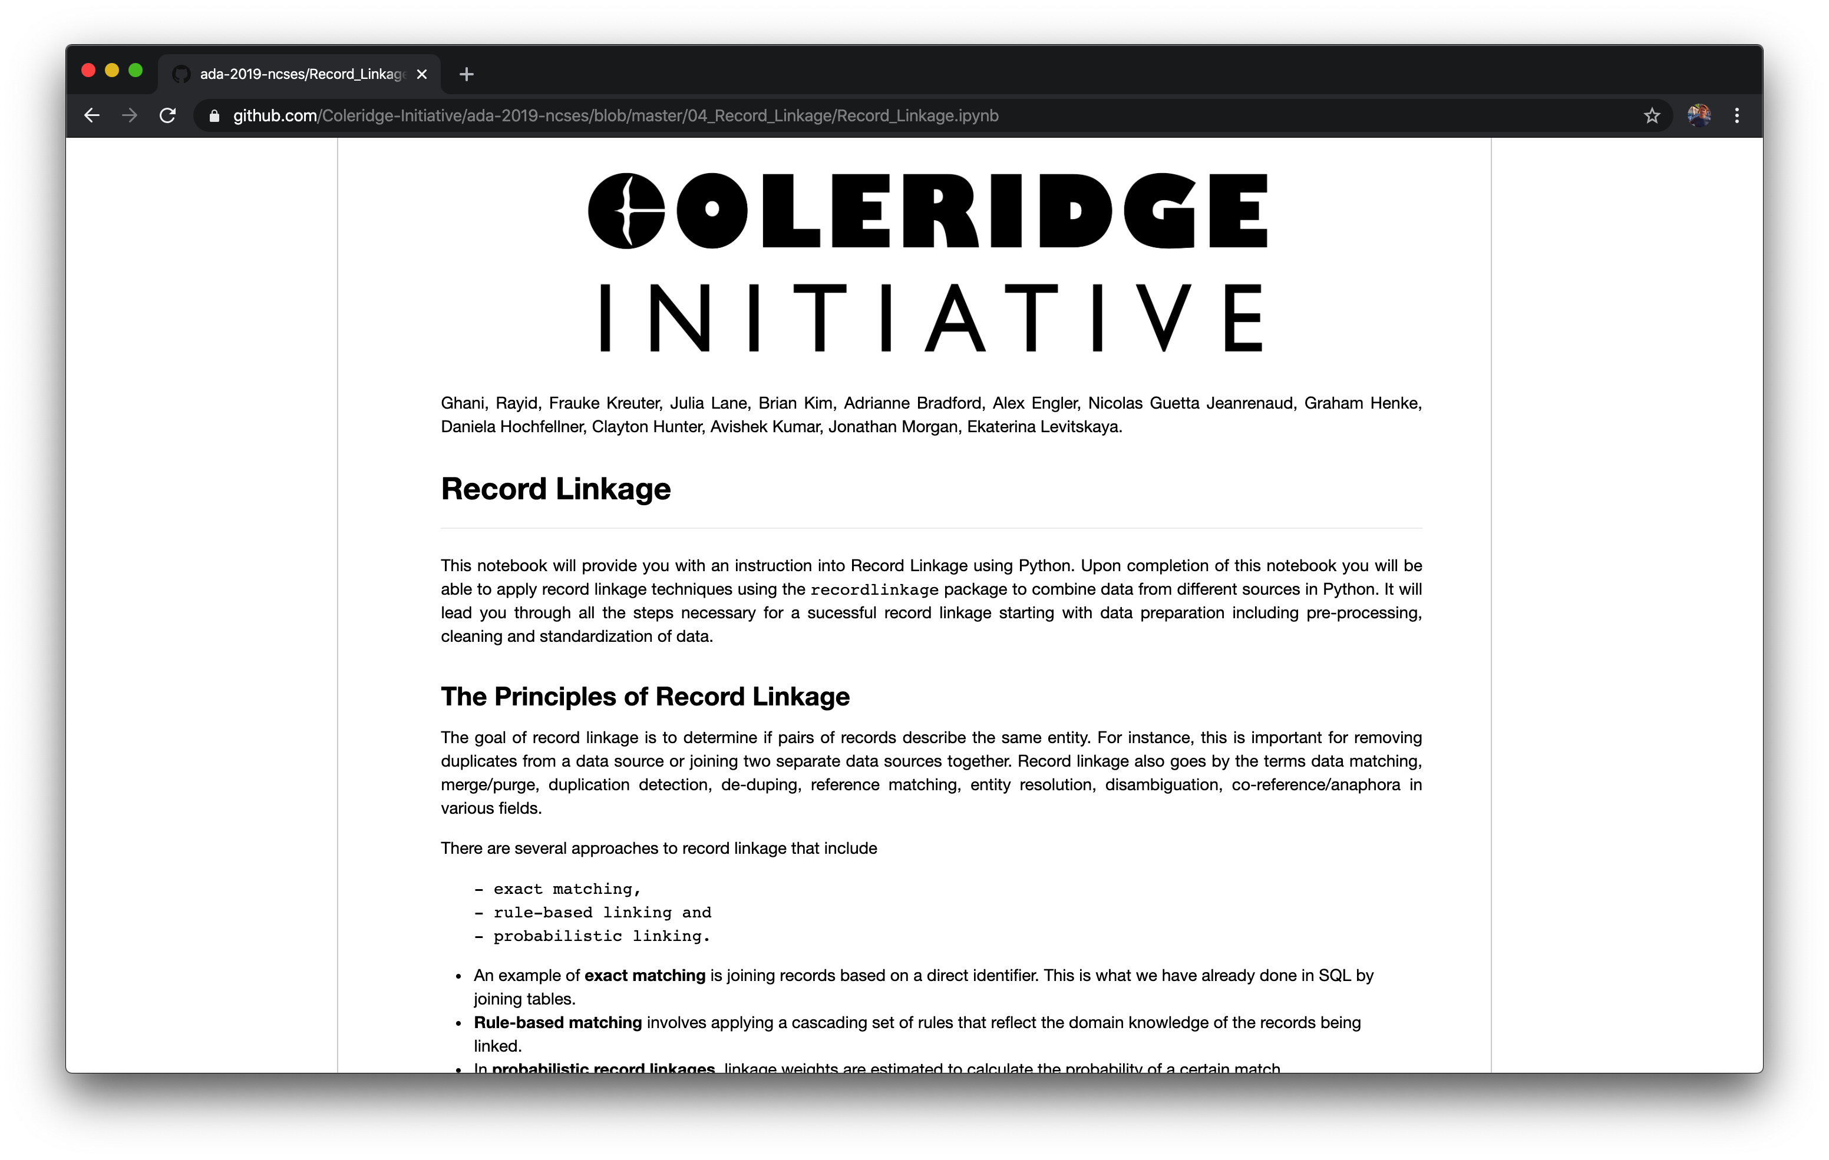
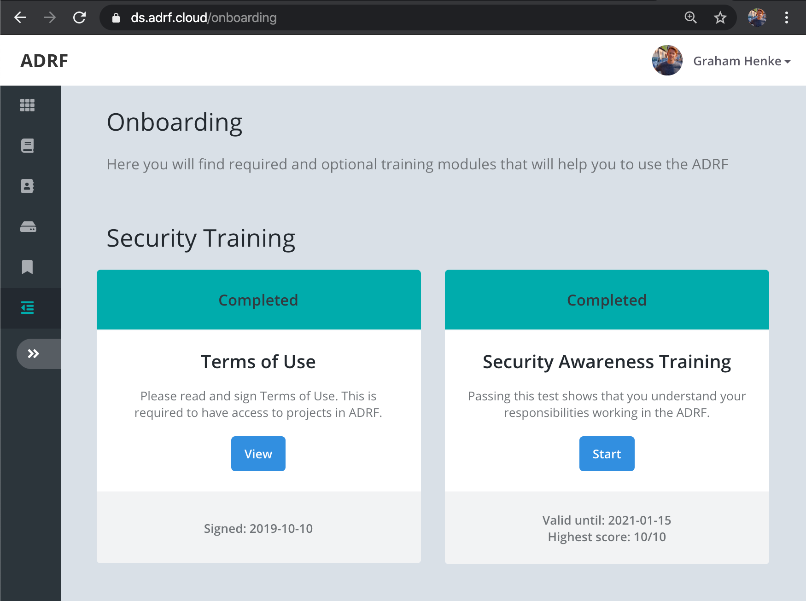
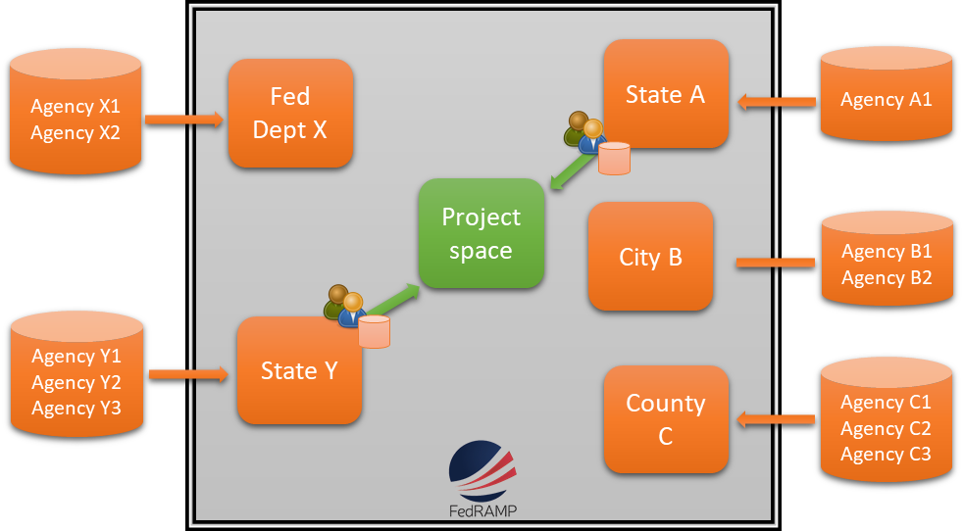
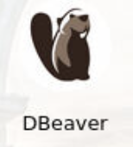
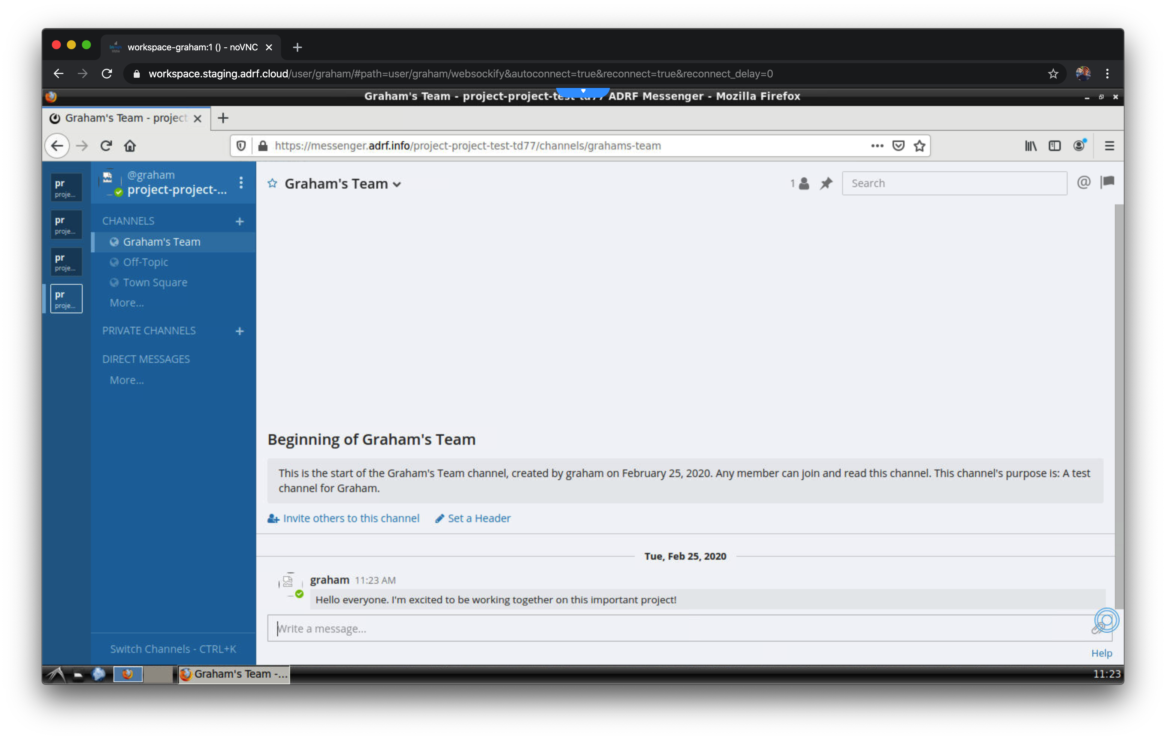



The ADRF Workspace
Using the Administrative Data Research Facility
SECURITY
FIVES SAFES FRAMEWORK
Safe Projects
All data access is controlled on a project by project basis. Projects must be approved by the Data Owners and be consistent with the agency’s mission.
Safe People
Only approved researchers who have undergone security training are allowed to work on projects.
Safe Settings
The ADRF is hosted within AWS GovCloud and has received Authorization to Operate from the Census Bureau, has achieved a FedRAMP Moderate approval and is listed on the FedRAMP Marketplace.
Safe Data
The data in the ADRF is deidentified (hashed).
Safe Outputs
Nothing can be exported from the ADRF until it has gone through a disclosure review process.
COMPUTATION
Remote Desktop Environment
The ADRF provides a remote desktop environment that is accessible from a web browser, which means no additional software is required.
COLLABORATION
Shared Project Folder
Each project workspace includes a shared folder and database schema so that researchers can easily share work with one another inside their workspace.
Project Templates
The ADRF has a number of Jupyter notebooks available which have many of the fundamental steps of common analysis patterns already written. Topics include databases, record linkage, text analysis, machine learning, and more.
Analysis Tools
A number of commonly used analysis tools are available for use, including Jupyter Lab, R Studio, and Stata, as well as Postgres and Athena for database storage and querying.
Kubernetes POD
Internal Messaging
The ADRF also provides the messaging app Mattermost (open-source Slack) so that researchers can communicate securely while inside the ADRF.
SSL
Database
Remote Desktop
SSL
AWS Athena
Project and personal folders
SSL
Project S3 Bucket
Workspace
Customizable workspace
Workspaces can be customized. Projects which may required additional analytical tools, software libraries, or computing and storage are available.
An example project request.
https://coleridgeinitiative.org

